Slide 1
Pathfinding in games

Slide 2
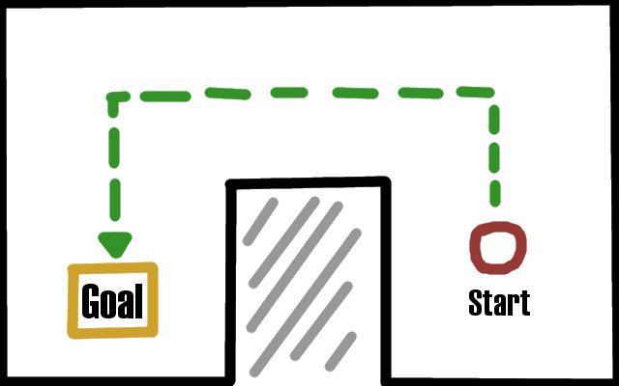
What problems are we trying to solve?
We want to move a character in our game from a start point to a goal point.
May occur when an AI character is moving through the game world.
May also occur if the player is being moved via a slightly indirect control method such as clicking the mouse to set a movement goal.
Desired path
Why is it hard?
Usually because game worlds contain obstacles, as shown in this example
Failure if we just try to move straight to goal

Slide 3
Breaking down the problem.
First - there isn’t one simple solution that will fit all situations; the exact nature of the problem will depend on the game being made and the tools available will have to be tailored to fit.
Second – Always check for the easy way first. A lot of the time a goal position and a start position can be reached with simple straight line movement, and it’s often easier to check if this is possible first before moving on to more complicated and computationally expensive pathfinding solutions.
Third – Simplify the representation of your game world ahead of time to only the necessary aspects to solve the problem. This is very useful for speeding everything up and making the problem easier to grasp. Lets have another look at our example from the previous slide to see how that can be done.

Slide 4
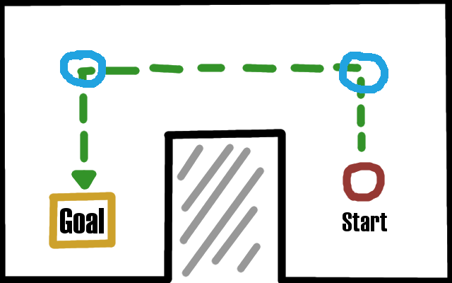

We can create a data structure to capture these useful points and the unobstructed paths between them and keep it as part of our game world data.
This kind of data structure is called a graph.
If we imagine two points at the corners of our desired path from start to goal, the paths sections between
each point of the path is now an unobstructed straight line.

Slide 5
Graph data structure
Not to be confused with the more common graph with an x and y axis. A graph data structure is defined by having nodes and edges, which are the connections between those edges.
A tree data structure is just a specialized subcategory of a graph data structure with additional restrictions.
For our purposes we need the nodes to represent positions in our game world (so in a 2D game they will contain an x & y position variable), and the edges of the graph will represent the unobstructed paths to our ‘neighbor’ nodes.

Slide 6
Example graph structure in code
Useful to pre-calculate the distance between nodes if it is different on each connection. Then we don’t need to calculate it when finding paths.
class NavigationNode:
def __init__(self, position:pygame.math.Vector2):
self.position = position
self.neighbour_connections = []
def add_connection(self, node):
distance = self.position.distance_to(node.position)
connection_edge = {“node”: node, “distance”: distance}
self.neighbor_connections.append(connection_edge)

Slide 7
Navigating the graph
In our example earlier the navigation graph of the ‘world’ was fairly simple with only four nodes and six directional connections. In many games though the worlds, and the resulting node graphs can be much, much larger and picking the correct path through them is not straight forward.
Lucky for us, finding a path through a graph data structure is a well explored problem and there are many algorithms available.
What these algorithms have in common is needing a start node and usually, a goal node and that they will then build a temporary tree data structure by exploring nodes one at a time, to try and find a complete path through the graph. As each node is explored it’s neighbor nodes will be added to the list of options available for future exploration and then the algorithms will loop.
Where the algorithms tend to differ is in the strategy used for picking which of the available nodes will be the next to be explored.

Slide 8
Depth-first search
Approach: Starting from the start node, pick the ‘deepest’ available node in our search tree to explore further. Stop when we find the goal node.
Increasing
depth
Start node
Advantages –
Tends to explore less nodes before finding the goal than other algorithms.
Disadvantages –
No guarantee that the found path is optimal in terms of number of nodes, in fact the more complicated the graph the less likely this is.
Doesn’t account for varying distances between nodes.
Unexplored nodes

Slide 9
Breadth-first search
Approach: Starting from the start node, explore every node at the same depth before looking at any deeper nodes. Stop when you find the goal node.
Advantages –
Finds ‘optimal’ paths to the goal node - optimal in terms of number of nodes explored.
Disadvantages –
Generally slower than depth first search because it explores so many nodes.
Doesn’t account for varying distances between nodes.
Increasing
depth
Start node
Unexplored nodes

Slide 10
Uniform-Cost search
Approach: explore the next available node with the lowest path cost. Path costs are calculated as we progress through the search tree by adding the distance/cost to reach the next node to the accumulated cost of getting to it’s parent node in the search tree. Where the costs/distances are the same between every node, this strategy will be equivalent to a breadth first search.
Start node
Advantages –
Finds ‘optimal’ paths to the goal node.
Disadvantages –
Generally slower than depth first search because it explores so many nodes & a tiny bit slower/more memory using than breadth first because of the extra information to track.
0
5
7
5
7
4
3
9
8

Slide 11
Uniformed vs Informed search
Breadth first and depth first are examples of uninformed search algorithms, other than the knowing the start node on the graph and whether they have reached the end node, they don’t use any other information about the world to pick which node to explore next.
Unsurprisingly we can improve the performance of our search algorithms if we give them (or have them calculate) a little bit more information about the world.
The simplest bit of information to use is ‘which node will take us closer to the goal?’ Usually as measured in a straight line distance from the potential node to explore and the goal node.

Slide 12
Handling repeated states
One important part of graph search algorithms that distinguish them from their tree search equivalents is that they need to handle repeated states.
For example, in a navigation graph it is possible to proceed from A to B and back from B to A. If we do not track that we have already visited and found a path to A then many of our algorithms will automatically head back to A again from B later on, in case it leads to the goal.
While the algorithms will still work, this wasted effort really adds up exponentially and on large graphs effectively makes many of them useless for practical search in a useful timespan.
To stop this we can just store explored/visited nodes in a list, known as the closed list, and only add to our exploration options newly available connecting nodes that are not already in the closed list.

Slide 13
Greedy Search
Approach: Explore the available node that is closest to the goal node as measured by a straight line distance. Stop when we reach the goal.
Advantages:
Will spend less time exploring many nodes that are heading away from our goal.
Disadvantages:
May explore many lengthy paths to dead ends just because the dead ends were close to our goal, meanwhile ignoring a straight forward path to the goal that requires a little backtracking to start down.

Slide 14
A* Search
Approach: Combine the techniques of Uniform-Cost and Greedy search to produce a combined estimation of a path’s cost-to-goal that takes the accumulated path cost (as in Uniform-Cost) and adds it to the straight line distance to the goal (as in greedy search). The next node to explore is then the one with lowest estimated cost to goal.
Advantages:
Finds optimum paths while skipping the exploration of nodes that are very unlikely to lead to the goal node, without getting too drawn into lengthy, seemingly promising paths that lead to dead ends.
Disadvantages:
A* is a bit of a jack-of-all-trades algorithm which means it performs well in a wide variety of situations, but also means that is possible to outcompete it in a lot of specific situations.
Note: the approach I sketch out above for A* using the straight line distance is just the most common formulation of what is known as the ‘admissible heuristic function’ for the algorithm. All that means is a method for estimating the remaining path cost that is lower than, or equal to, the true path cost.

Slide 15
Dijkstra’s algorithm
Approach: Calculate the shortest path cost from the start node to all other nodes in the graph. Works much like Uniform-cost search except we don’t stop searching when we find a goal, we find a path to every node.
Advantages:
If we have a particular location that our AIs need to continually find a path to from anywhere in the world - e.g. the ghost box in Pac-Man where the ghost’s respawn - then we can pre-calculate and store optimum paths for the ghosts back to the box from every location and just grab the correct path when we need it, making it the fastest option available during play.
Disadvantages:
Storing all the paths calculated by Djikstra’s algorithm can use up a lot of memory, especially if you repeatedly use it to calculate the paths from every node to every other node in a large node graph.

Slide 16
To the code!
As usual copy the code folder for this week from S:/COMPUTER SCIENCE/CS CLUB 2 – Electric Boogaloo/ to your personal drive/folder if you are using a school computer.
This week we are using the pygame module and the latest version of the pygame_gui module, if they are not already installed on the computer you are using download them using PyCharm or using Powershell.
Have a play with the algorithm visualizer.

